Slide 1
TRIP: Jan 18, 2022 Who has hypercapnic respiratory failure (and why)?
Brian Locke, MD Pulmonary and Critical Care Fellow; 1st year MSCI
Team:
Krishna Sundar, MD P/CCM
Jeanette Brown, MD PhD P/CCM
Ram Gouripeddi MBBS MS

Slide 2
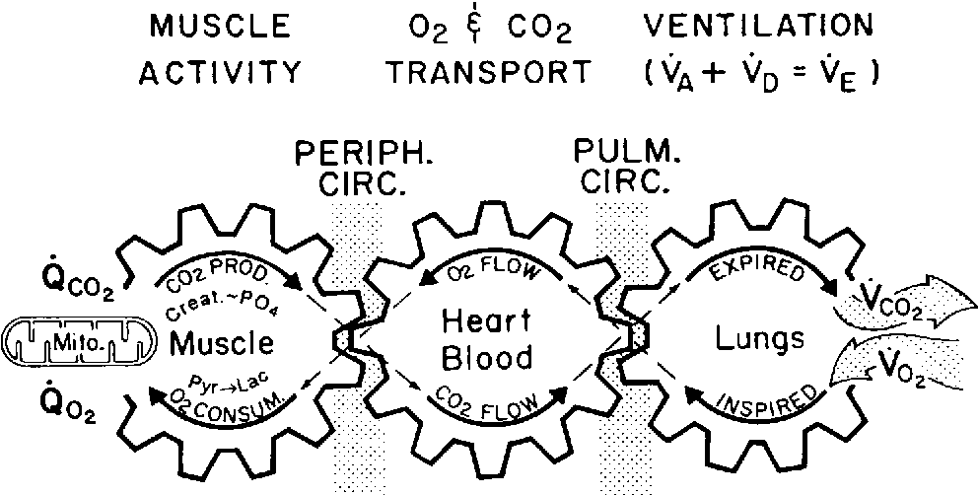
Respiratory Failure: failure to maintain O2 or CO2 levels in the blood
If the R ‘sprocket’ (lung) turns too slowly relative to the L sprocket (muscle), CO2 build up in the blood
This is hypercapnic respiratory failure
Similar: ‘hypoventilation’, ‘hypercapnia’
There are 2 types of causes:
The lung ventilation is severely broken (sprocket can’t turn fast)
The ‘controller’ doesn’t crank up the speed of the sprocket.
Build up here = CO2 in blood rises
Notes:
Explanation
Variety of disease processes can lead to the clinical syndrome
Can’t breathe: COPD, fibrotic lung disease, muscle weakness
Won’t breathe: opiates, obesity

Slide 3
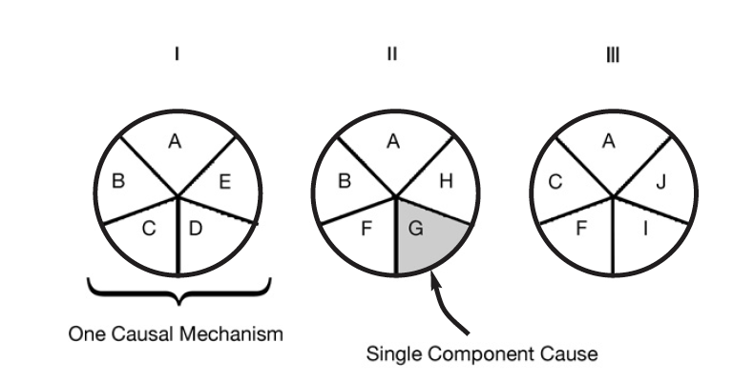
Sufficient-Component Cause Model
Sufficient cause: a set of factors that will cause disease when present
Component cause: a factor that, if not present, no disease would occur
Necessary cause: in all sufficient cause sets, this component must be present
3 Different Sufficient Causes
A = Necessary Cause
A – J = Component Cause
Notes:
Hypothesis
Rothman KJ. Am J Epidemiol 1976; 104: 587-592.
a sufficient cause as "...a complete causal mechanism" that "inevitably produces disease." Consequently, a "sufficient cause" is not a single factor, but a minimum set of factors and circumstances that, if present in a given individual, will produce the disease.

Slide 4
Causes of Hypercapnia
[Area represents a population of patients]
Severe COPD
Sufficient Cause
If PaCO2 > 52 mmHg, 2-4 weeks after exacerbation -> nighttime ventilation improves outcomes
*no other causes of ↑️ CO2
Notes:
Hypercapnic respiratory failure is uncommon and can be acute or chronic.
The symptoms are variable, and the diagnosis is frequently missed.
Each case of hypercapnic respiratory failure may have several necessary causes.
Prior research exclusively focused on sufficient causes
Perhaps effect modification?
Patients who develop hypercapnic respiratory failure have many comorbidities that may act as confounders

Slide 5
Causes of Hypercapnia
Obesity Hypovent
Sufficient Cause
BMI over 35, no other lung dz, PaCO2>45 – nocturnal ventilation improves outcomes
*no other causes of ↑️ CO2
Severe COPD

Slide 6
Causes of Hypercapnia
Obesity Hypovent
Severe COPD
ALS
Sufficient Cause
FVC <50%, nocturnal hypoventilation or sleep problems -> nocturnal ventilation improves outcomes
*no other causes of ↑️ CO2
Notes:
Hypercapnic respiratory failure is uncommon and can be acute or chronic.
The symptoms are variable, and the diagnosis is frequently missed.
Each case of hypercapnic respiratory failure may have several necessary causes.
Prior research exclusively focused on sufficient causes
Perhaps effect modification?
Patients who develop hypercapnic respiratory failure have many comorbidities that may act as confounders

Slide 7
Causes of Hypercapnia: Hypothesis
Obesity as Component Cause
Obesity Hypovent
COPD as Component Cause
Severe COPD
ALS
Muscular weakness as Component Cause
Notes:
This is my overall research goal to investigate

Slide 8
Causes of Hypercapnia: Hypothesis
Sleep Apnea as Component Cause
Obesity as Component Cause
Obesity Hypovent
COPD as Component Cause
Loop Diuretics as Component Cause
Severe COPD
ALS
Opiates as Component Cause
Muscular weakness as Component Cause
Notes:
Hypercapnic respiratory failure is uncommon and can be acute or chronic.
The symptoms are variable, and the diagnosis is frequently missed.
Each case of hypercapnic respiratory failure may have several necessary causes.
Prior research exclusively focused on sufficient causes
Perhaps effect modification?
Patients who develop hypercapnic respiratory failure have many comorbidities that may act as confounders

Slide 9
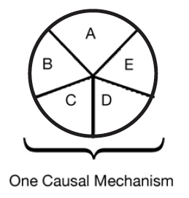
Multicausality
Hypothetical patient with hypercapnic respiratory failure
Sufficient cause: a set of factors that will cause disease when present
Component cause: a factor that, if not present, no disease would occur
Necessary cause: in all sufficient sets, this component must be present
COPD
Obesity
Loop diuretic
Untreated
Sleep Apnea
Opiates
Notes:
“Perhaps the most important of these principles is self-evident from the model: A given disease can be caused by more than one causal mechanism, and every causal mechanism involves the joint action of a multitude of component causes”’
“The importance of multicausality is that most identified causes are neither necessary nor sufficient to produce disease. Nevertheless, a cause need not be either necessary or sufficient for its removal to result in disease
prevention. If a component cause that is neither necessary nor sufficient is blocked, a substantial amount of disease may be prevented."
Rothman and Greenland

Slide 10
Is there evidence for multicausality?
Overall prevalence of OSA ( AHI > 30 ) in survivors over 50%
P (OSA | Hypercapnia & ICU) >> P (OSA | ICU)
**association, not causation
Admitted to ICU with PaCO2 over 45 mmHg and a pH less than 7.35
Notes:
Sleep apnea as sufficient cause? Kinda. Called OHS in that setting.

Slide 11
”Yes, of course. Who cares?”
What are the common component causes of hypercapnia?
Need pretest probabilities to inform rational diagnostic testing
What proportion of cases do we have evidence to inform management decisions?
Might all the other patients benefit from nocturnal ventilation?
Payors won’t pay for machine without evidence.
Why haven’t these questions been answered?
Notes:
This is the common response.
How common is hypercapnic respiratory failure?
Burden of disease ~ prevalence * severity

Slide 12
Inferential leaps:
Are common comorbidities Associations vs Causes? Takes additionally robust study designs to know for sure.
Current proposal: e.g., risk of readmission
Inferences about effects who to generalize previously demonstrated treatments to: The Reference Class Problem.. Are patients with “component cause” COPD likely to benefit in the same way that “Sufficient cause” COPD are?
EBM: Reference class problem -> default to people included in the trial population, not necessarily “similar physiology”
NIV is PAYOR dependent – thus whether or not clinicians make this leap, payor’s will likely only pay for treatments under a population of interest.
For other intervention, it is at the clinician discretion.

Slide 13
Where do we draw this line? (who is included as a ’case’)
All cases of hypercapnic respiratory failure
Sleep Apnea as Component Cause
Obesity as Component Cause
Obesity Hypovent
COPD as Component Cause
Loop Diuretics as Component Cause
Severe COPD
ALS
Opiates as Component Cause
Muscular weakness as Component Cause
Notes:
Hypercapnic respiratory failure is uncommon and can be acute or chronic.
The symptoms are variable, and the diagnosis is frequently missed.
Each case of hypercapnic respiratory failure may have several necessary causes.
Prior research exclusively focused on sufficient causes
Perhaps effect modification?
Patients who develop hypercapnic respiratory failure have many comorbidities that may act as confounders

Slide 14
Case definition: hypercapnic respiratory failure
Acute Hypercapnic Respiratory Failure
Chronic Hypercapnic Respiratory Failure
Acute Hypercapnic Respiratory Failure
PaCO2 over 45 mmHg (at sea level)
Up to 10 mmHg higher in REM sleep
Challenges:
Construct validity:
Hypercapnic respiratory failure can be transient, acute, or chronic.
Arbitrary thresholds
Informed presence bias; diagnosis frequently missed
= People who have information in the EHR differ from those who do not.
Blood gasses hurt to obtain, not commonly obtained unless clinicians suspect diagnosis
There are no specific symptoms
What would the ABG have shown, if it were checked? Hard to predict
Stability
Normalization of Hypercapnia
Stability
Notes:
Case definition in epidemiology
[ ] talk about informed presence bias

Slide 15
How is the current literature identifying hypercapnia?
Diagnostic Code-Based
Admitted (ICU or floor) with one of the following diagnostic codes:
J96.02 (acute hypercapnic respiratory failure)
J96.22 (acute and chronic respiratory failure with hypercapnia)
J96.92 (respiratory failure unspecifed with hypercapnia)
J96.12 (chronic respiratory failure with hypercapnia)
E66.2 (morbid obesity with hypoventilation)

Slide 16
Currently, how is hypercapnia identified?
Lab-Based
Admitted to hospital (Floor or ICU) with ABG showing PaCO2 over 45 mmHg and pH 7.35-7.45

Slide 17
Currently, how is hypercapnia identified?
Lab and procedure code-Based
Admitted to the ICU
PaCO2 greater than 47.25 mmHg
Procedure code for non-invasive ventilation or invasive mechanical ventilation initiation

Slide 18
Project 1: Hypotheses
The methods used in prior studies of hypercapnic respiratory failure identify different patients
Hypothesis 1: the sensitivity (aka recall) and positive predictive value (aka precision) for both billing code- and procedural code-based identification of hypercapnic respiratory failure will be below 80%, when compared to blood gas-based identification as the reference standard.
The populations identified by differ in risk for outcomes of interest, which hampers interpretation of these studies.
Hypothesis 2: The distribution of age, ethnicity, BMI, Elixhauser comorbidity score, and frequency of coexisting diagnoses (OSA, opiate use disorder, COPD, CHF, and neuromuscular disease) will differ between the cohorts identified by each method.
Notes:
Will discuss why not Se and Sp
Will discuss why blood gas taken as a reference standard.
Hypothesis 2: The distribution of age, ethnicity, BMI, Elixhauser comorbidity score, and frequency of coexisting diagnoses (OSA, opiate use disorder, COPD, CHF, and neuromuscular disease) will differ between the cohorts identified by each method.

Slide 19
Data source:

Slide 20
Data source:
Research Network: 73 million MRNs from ~53 academic medical centers (including U of U)
De-identified, patient-level data (not PHI, though recommended to be treated as such)
Data Available | Data unavailable
Demographics Diagnosis Medications Procedures - what procedures were done. E.g. sleep study code Labs Cancer registry (NAACCR) Allergies | Some notes* Diagnostic reports DICOM image objects Providers Departments/clinics
Notes:
Added some fudging to dates, exclusion of rare conditions to ensure that it’s not re-identifiable.

Slide 21
Data request:
69 million MRNs; ~50 academic medical centers (including U of U)
De-identified data (not PHI, though recommended to be treated as such)
Cannot be geolocated or tracked to a specific center

Slide 22
We requested patient level data from all records with an inpatient encounter and any of:
Diagnostic code for hypercapnic respiratory failure
Arterial blood bas with hypercapnia (45 mmHg+)
Procedure code for initiation or management of non-invasive ventilation
N= 501,925 patients.
Notes:
(bolded = correct classifications for hypercapnia; non-bolded = incorrect, but likely common, misclassifications of hypercapnia)
J96.12 (chronic respiratory failure with hypercapnia),
J96.02 (acute hypercapneic respiratory failure),
J96.22 (acute and chronic respiratory failure with hypercapnia),
J96.92 (respiratory failure unspecified with hypercapnia),
E66.2 (morbid obesity with hypoventilation)
J96 Respiratory Failure, not otherwise specified
J96.00 Acute Respiratory Failure, unspecified whether hypoxia or hypercapnia
J96.01 Acute respiratory failure, with hypoxia
J96.1 Chronic Respiratory Failure
J96.10 Chronic Respiratory Failure, unspecified whether hypoxia or hypercapnia J96.11 Chronic Respiratory Failure with hypoxia
J96.2 Acute and Chronic Respiratory Failure
J96.20 Acute and Chronic Respiratory Failure, unspecified whether hypoxia or hypercapnia
J96.21 Acute and Chronic Respiratory Failure, with hypoxia
J96.90 Respiratory Failure, unspecified whether with hypoxia or hypercapnia (most common in TrinetX)
J96.91 Respiratory Failure, unspecified with hypoxia
Specific Procedure Codes:
Assistance with Respiratory Ventilation, 0-24 hours; 24-96 hours; and longer than 96 hours
Management of non-invasive ventilation
Respiratory Ventilation, 0-24 hours; 24-96 hours; and longer than 96 hours
Ventilator Management
Ventilation Assist and Management.. initial; first day; and subsequent day
ICD-10: Mechanical Ventilation - 5A1935Z, 5A1945Z, 5A1955Z
Specific Blood gas codes:
LOINC 2019-8 Carbon Dioxide [ Partial Pressure ] Arterial Blood over 45
LOINC 2026-3 Carbon Dioxide, total [ Moles/Volume] in Arterial Blood over 45
LOINC 32771-8 Carbon Dioxide [ Partial Pressure] adjusted to patient’s actual temperature in arterial blood over 45
LOINC 11557-6 Carbon Dioxide [ Partial Pressure] in Blood

Slide 23
Embedded data analysis tools

Slide 24
Statistical Analysis Plan: why not Se/Sp?
Example Calculation | ICD code = ‘Prediction’ | ICD code = ‘Prediction’
Blood gas = reference standard |  | ICD Code for Hypercapnic RF | No ICD code for Hypercapnic RF
Blood gas = reference standard | PaCO2 >= 45mmHg | True Positive | False Negative | Sensitivity TP / (TP + FN) (=Recall)
 | PaCO2 < 45mmHg (or no ABG) | False Positive | True Negative [Huge Number, not very informative] | Specificity TN / (TN + FP)
 |  | PPV TP / (TP + FP) (=Precision) | NPV TN / (TN + FN)
Notes:
Precision-Recall = Information Retrieval Terminology
Sensitivity = aka recall
PPV = aka precision
These indices are preferred when there is an imbalance In the in presence/absence of disease (ie, people without hypercapnic RF are much more common) – Se / Sp not wrong, but also not maximally informative.
FDA language for what to call the metrics when there is no guidance
Relative Sensitivity
Positive percent agreement

Slide 25
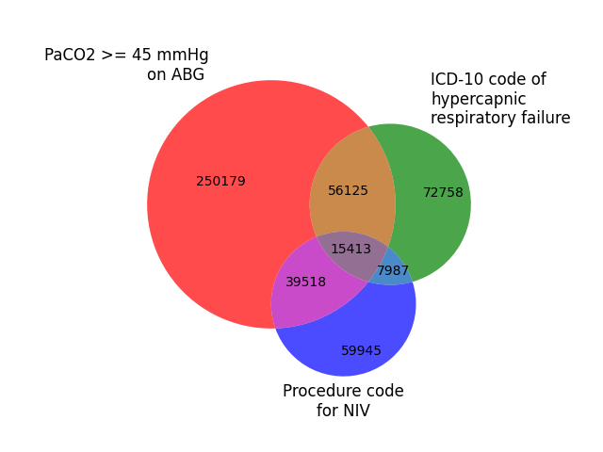
Preliminary Results
Using TriNetX Embedded Tools*
ICD Group:
Relative sensitivity (vs ABG): 19.8%
Positive Predictive Agreement (vs ABG): 47.0%
NIV Group:
Relative sensitivity (vs ABG): 15.2%
Positive Predictive Agreement (vs ABG): 45.2%

Slide 26
Preliminary Results
 | ABG Group | ICD Group | NIV Group
Age | 62±18 | 65±16 | 62±17
% Female | 46% | 51% | 42%
% white | 66% | 71% | 65%
% Black | 18% | 19% | 17%
BMI | 30.4±8.3 | 33.1±10.3 | 29.1±8.2
% with CHF | 37% | 30% | 19%
% with COPD | 31% | 30% | 14%
% Opiate UD | 6% | 3% | 3%
% Sleep Apnea | 23% | 24% | 10%
… + columns for each permutation

Slide 27
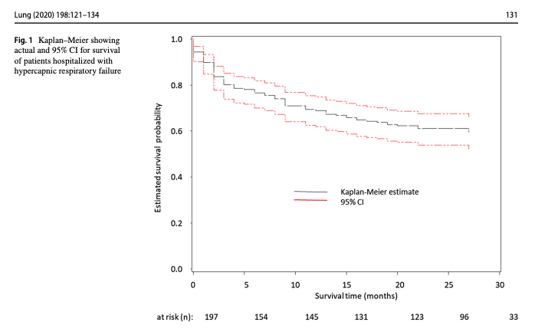
Implications:
For accurate determination of
Frequency of different comorbidities or causes
Morbidity and mortality associated with hypercapnia
Who should be included in studies to determine benefit from treatment
... method of patient identification likely matters
Interpretability of current research could be improved using standard case definitions

Slide 28
Challenges: Data Quality
U of U does not submit ABG results to TriNetX
Each individual patient MUST have been eligible to be identified by each strategy.
How to avoid similar issues at other institutions?
presence of each type of information (blood gas, RT proc code, and ICD) associated with the encounter
Selection bias: restricts eligible patients. Ideally, want to know performance whether or not ABG obtained.
data check for submission of all 3 types of information from each institution
Assumption: data missingness determined by institution-level policies
Variability in practices by institution
Bug, or feature?
Notes:
Another method will be to only include patients that have each of those things checked (ie. a blood gas of some sort, a diagnosis of some sort, and a procedure management code of some sort)

Slide 29
Challenges: Reference Standard
What should the reference standard be? (re: construct validity)
Does transient elevation PaCO2 after opiate administration imply respiratory failure?
Technically yes, but the implication of the diagnosis is much different
How much heterogeneity should the definition have?
Current PaCO2 threshold (45mmHg at sea level; 42 mmHg in SLC) are arbitrary
No epidemiologic data to support.
Different threshold used for different questions (NIV in COPD 52 mmHg; 45 mmHg other)

Slide 30
Computable Phenotype
Informed presence bias: people who have information in the EHR differ from those who do not.
EHR Computable Phenotype: an algorithm to classify patients based on the information present in the EHR
EHR Computable phenotype for Hypercapnic Respiratory Failure?
How should reference standard be determined?
Physician adjudication? = Chart Review
Based on some outcome measure: ie, risk of mortality or readmission
Helpful for trial definitions

Slide 31
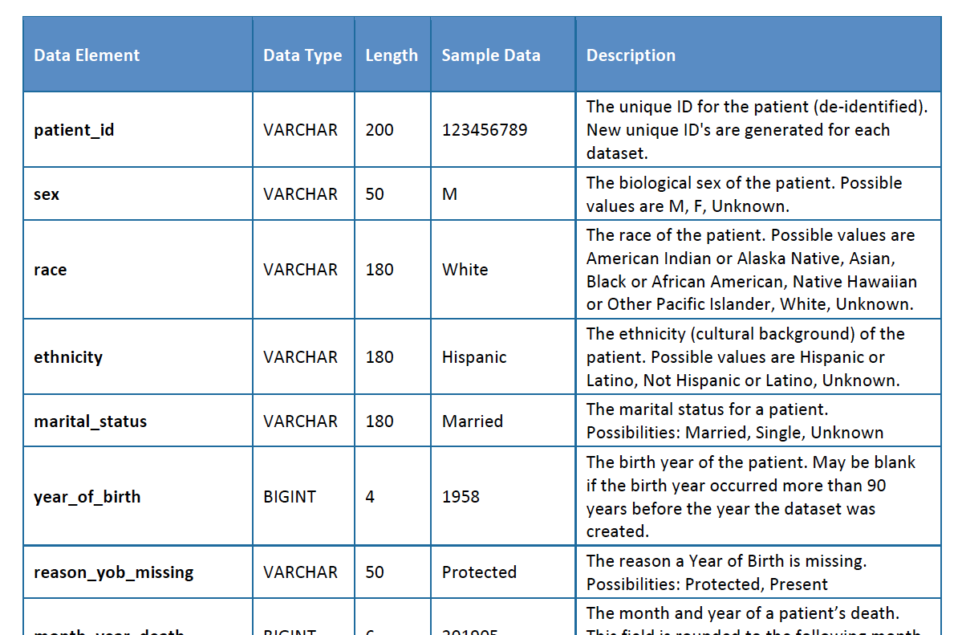
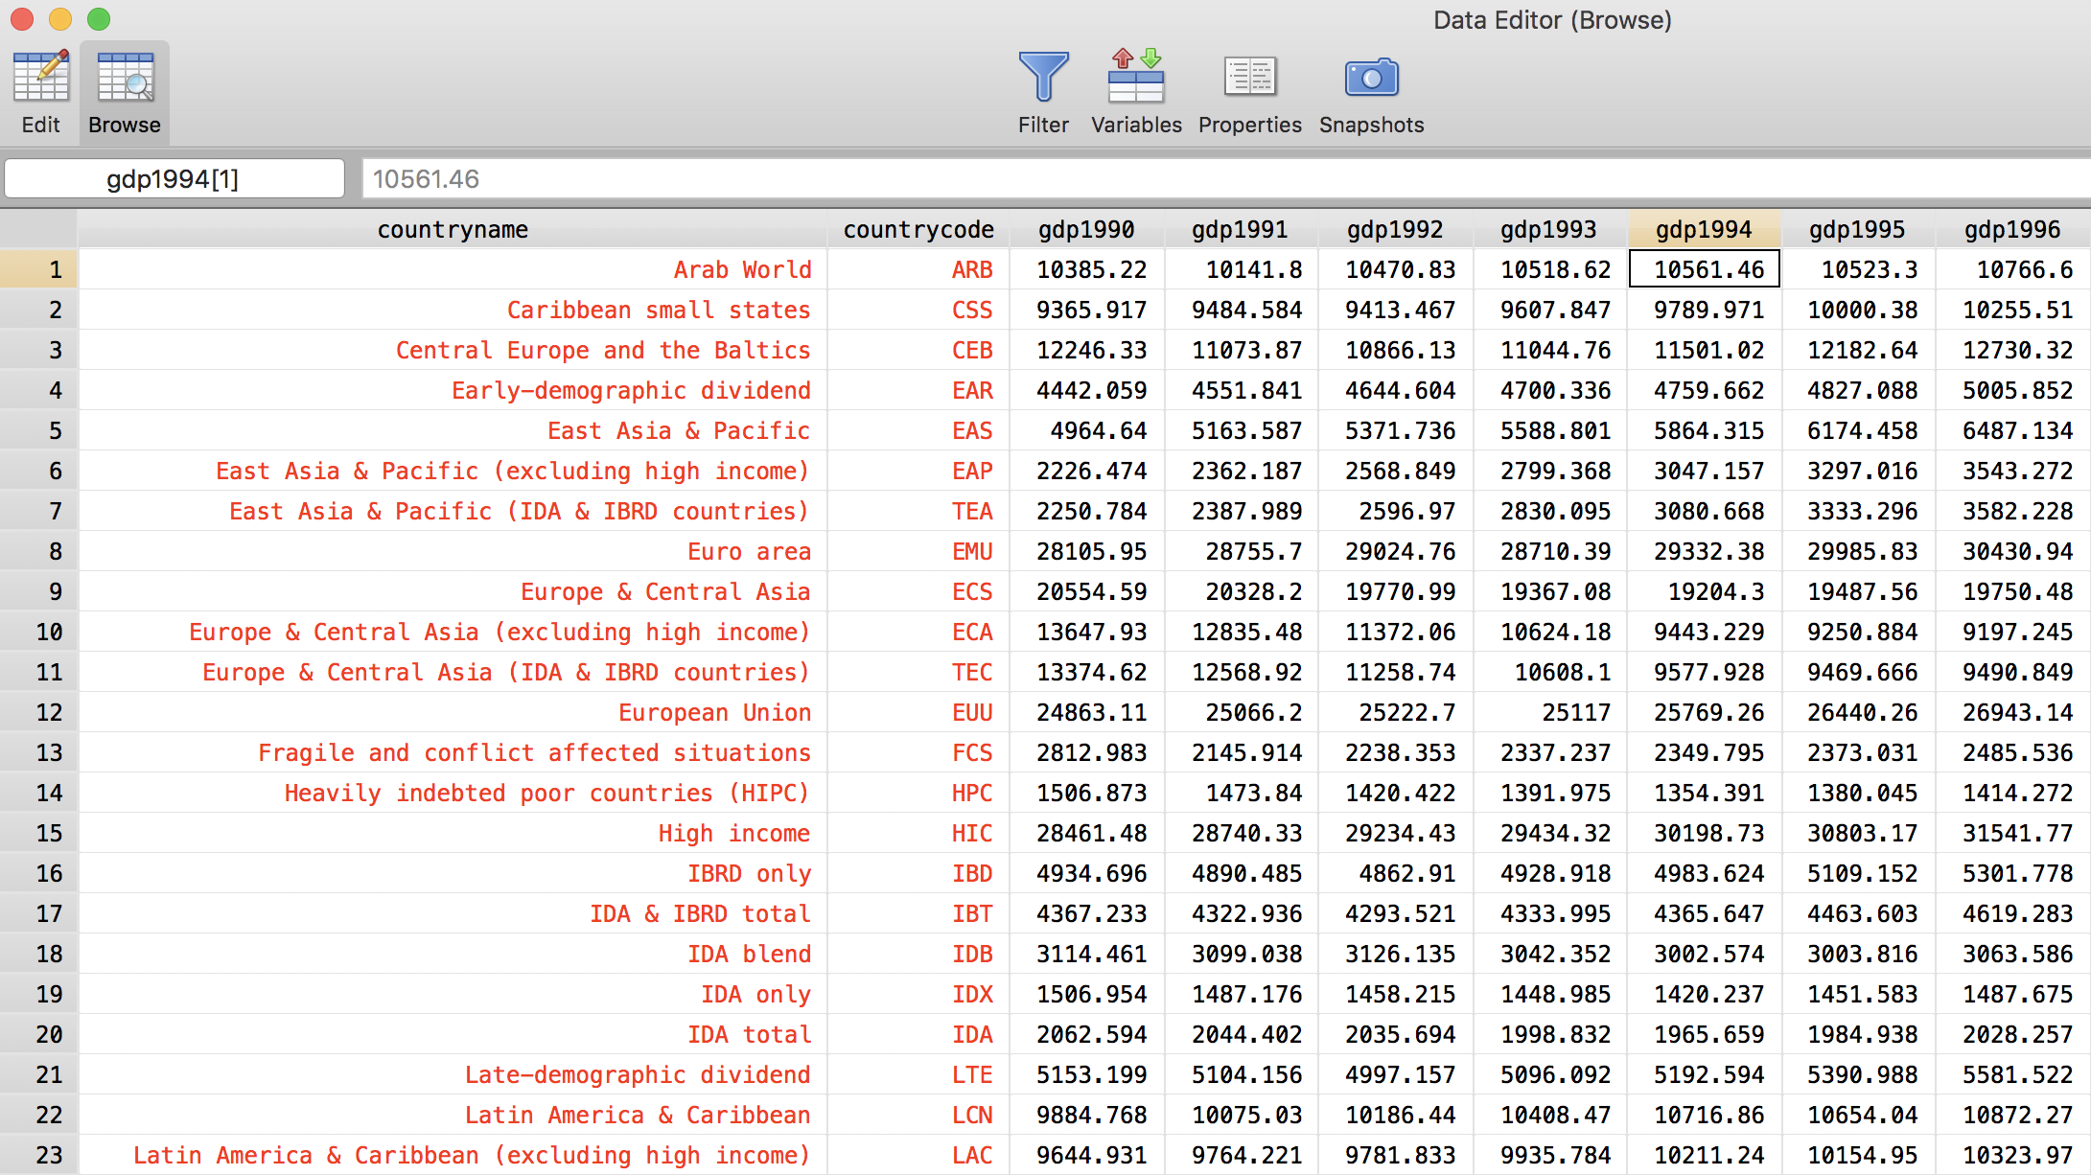
Next steps
To achieve initial aims:
Data quality checks; requires relational database processing. Currently ongoing
Additional aims?
TriNetX has record-linkage with mortality registries (Social Security; Obituary Databases). Does the cohort definition influence risk of mortality?
Stratification by ICU admission?
Notes:
[ ] also need to resolve labs, codes, and procedures to the same encounter.

Slide 32
Summary; Where Will This Lead?
Hypercapnic Respiratory is better understood by multicausality
Which component causes commonly lead to disease? TBD
Are there component causes that are not generally mono-causal sufficient causes? Impact of loop diuretic prescription on risk of readmission with hypercapnia
Current methods identify meaningfully different cohorts; standard definitions needed to answer:
What are the costs/morbidity/mortality of hypercapnic patients?
How large is the burden to society (incidence, mortality)?
How small is the subset of patients we currently have evidence to treat?
Will treating other patients with hypercapnia improve outcomes?
Mechanistic reasoning suggests it should; we need data for payors
Notes:
Summary

Slide 33
Questions?
References:
Comments?
Ideas?
Email: brian.locke@hsc.utah.edu
Sufficient-Component Cause Model:
Rothman, K. J. (1976). Causes. American journal of epidemiology, 104(6), 587-592.
Rothman, K. J., & Greenland, S. (2005). Causation and causal inference in epidemiology. American journal of public health, 95(S1), S144-S150.
Hypercapnia Graphic
Wasserman, Karlman, et al. "Principles of exercise testing and interpretation." Journal of Cardiopulmonary Rehabilitation and Prevention 7.4 (1987): 189.
Precision-Recall vs Sensitivity Specificity for Imbalanced Data
Saito, T., & Rehmsmeier, M. (2015). The precision-recall plot is more informative than the ROC plot when evaluating binary classifiers on imbalanced datasets. PloS one, 10(3), e0118432.
Prior Hypercapnic Respiratory Failure Cohorts
Meservey, A. J., Burton, M. C., Priest, J., Teneback, C. C., & Dixon, A. E. (2020). Risk of Readmission and Mortality Following Hospitalization with Hypercapnic Respiratory Failure. Lung, 198(1), 121–134.
Ouanes-Besbes, L., Hammouda, Z., Besbes, S., Nouira, W., Lahmar, M., Ben Abdallah, S., Ouanes, I., Dachraoui, F., & Abroug, F. (2021). Diagnosis of Sleep Apnea Syndrome in the Intensive Care Unit: A Case Series of Survivors of Hypercapnic Respiratory Failure. Annals of the American Thoracic Society, 18(4), 727–729.
Wilson, M. W., Labaki, W. W., & Choi, P. J. (2021). Mortality and Healthcare Use of Patients with Compensated Hypercapnia. Annals of the American Thoracic Society, 18(12), 2027–2032.
Adler, D., Pépin, J. L., Dupuis-Lozeron, E., Espa-Cervena, K., Merlet-Violet, R., Muller, H., Janssens, J. P., & Brochard, L. (2017). Comorbidities and Subgroups of Patients Surviving Severe Acute Hypercapnic Respiratory Failure in the Intensive Care Unit. American journal of respiratory and critical care medicine, 196(2), 200–207.

Slide 34
”Yes, of course. Who cares?”
Hypercapnia appears to be very bad
Notes:
This is the common response.

Slide 35
”Yes, of course. Who cares?”
These component causes are becoming extremely common
BMI 40+: 1990 - 2030
Notes:
This is the common response.

